Slide 1
Lecture 5

Slide 2
How do Maxwell’s Equations Imply Waves?
math

Slide 3
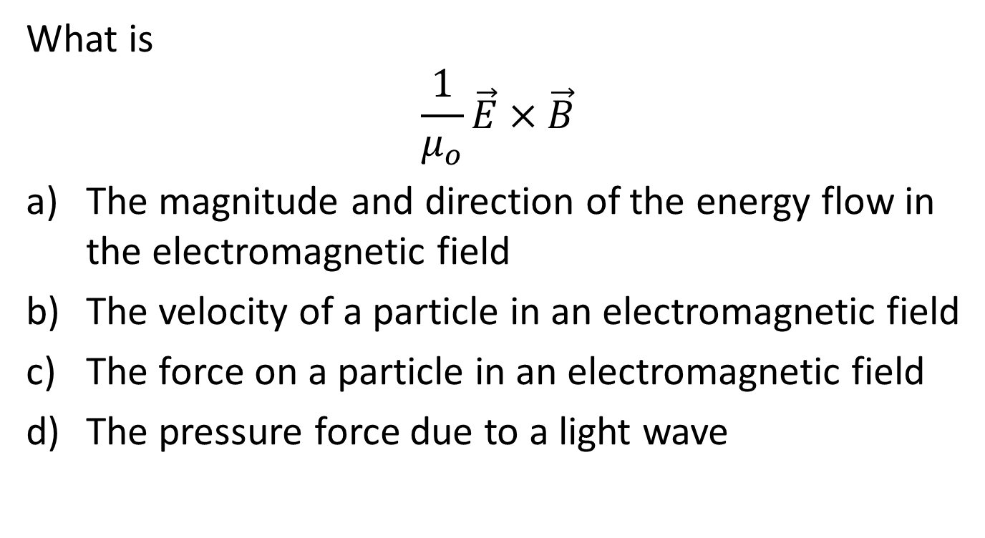
Question
What is
$$\frac{1}{μ_{o}}\vec{E}×\vec{B}$$
The magnitude and direction of the energy flow in the electromagnetic field
The velocity of a particle in an electromagnetic field
The force on a particle in an electromagnetic field
The pressure force due to a light wave

Slide 4
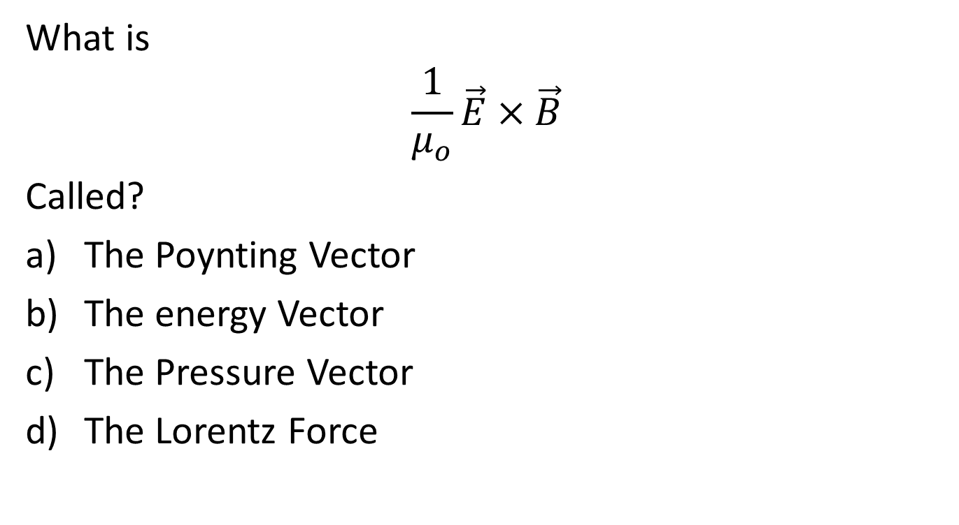
Question
What is
$$\frac{1}{μ_{o}}\vec{E}×\vec{B}$$
Called?
The Poynting Vector
The energy Vector
The Pressure Vector
The Lorentz Force

Slide 6
Question
What is the direction of energy flow for a circular current loop?
Along the wire
Out of the battery and into the wire
I
E

Slide 7
Question
What is the direction of energy flow for a circular current loop?
Along the wire
Out of the battery and into the wire
I
+
+
+
-
E
-
-

Slide 8
Question
What is the direction of energy flow for a circular current loop?
Along the wire
Out of the battery and into the wire
I
+
+
+
-
E
-
-

Slide 9
Question
What is the direction of energy flow for a circular current loop?
Along the wire
Out of the battery and into the wire
I
+
+
+
-
E
-
-

Slide 10
Question
What is the direction of energy flow for a circular current loop?
Along the wire
Out of the battery and into the wire
S
I
S
S
+
+
+
S
S
S
S
-
E
-
-
S
S

Slide 11
Question
The intensity of an electromagnetic wave is proportional to
E²
B²
c
S

Slide 12
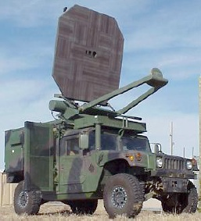

Slide 13
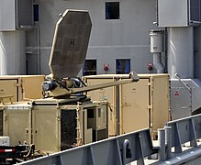
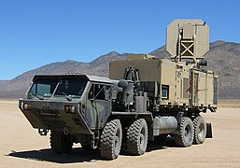
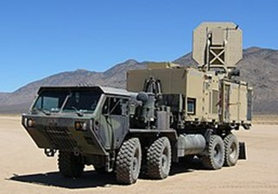

Slide 15
Question
Can you push something with a light wave?
Yes
No
Maybe

Slide 16
Question
How much pressure do we get from a light wave?
S/c
2S/c
B²
0

Slide 17
cΔ
A

Slide 18
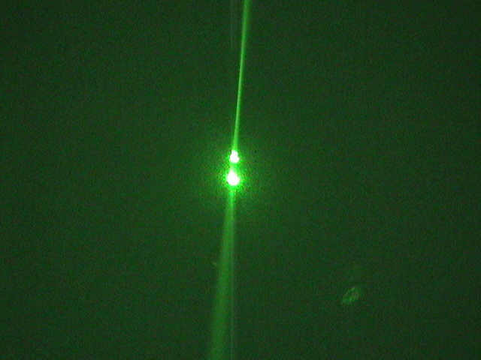

Slide 19
End

Slide 20
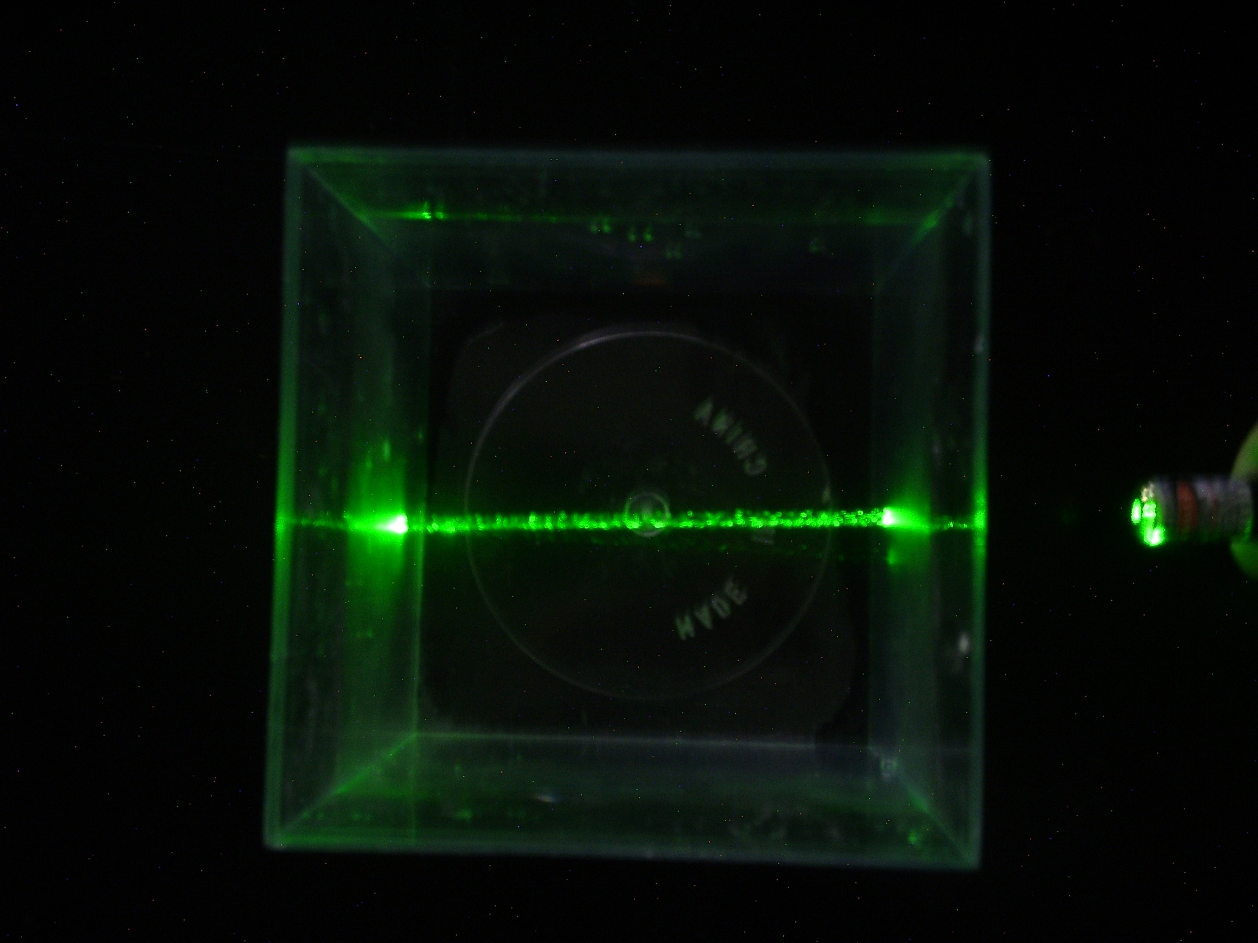

Slide 21
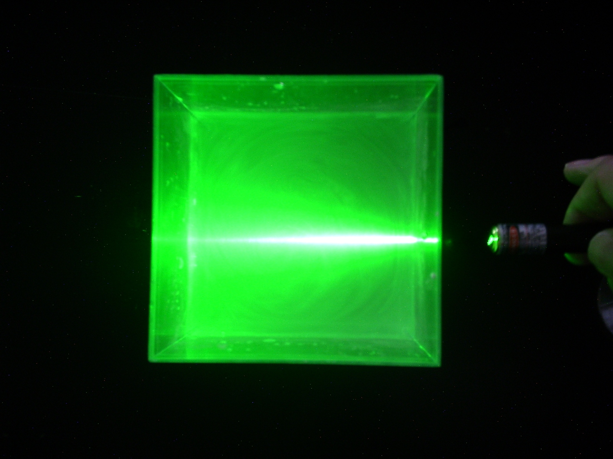

Slide 22
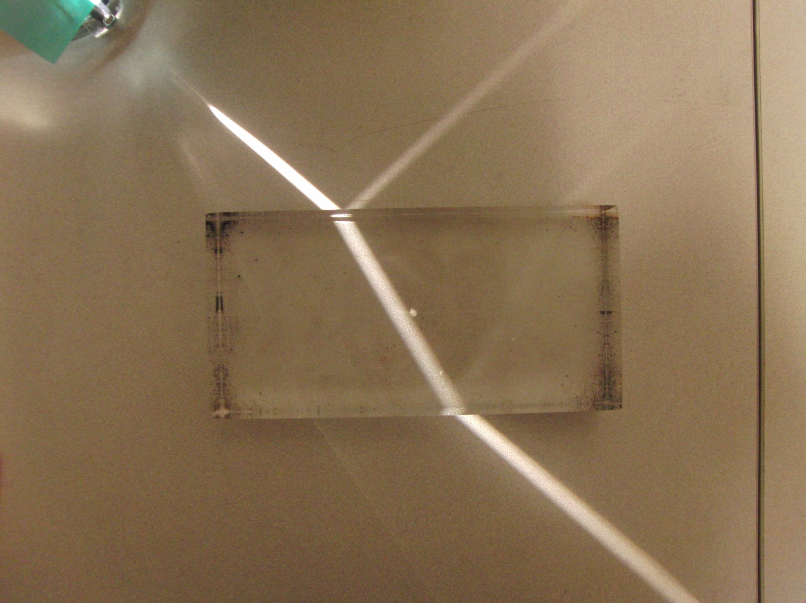

Slide 23
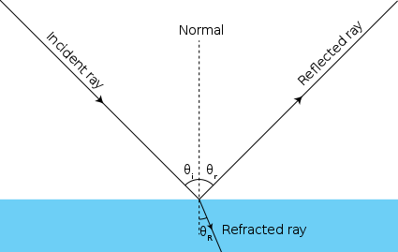

Slide 24
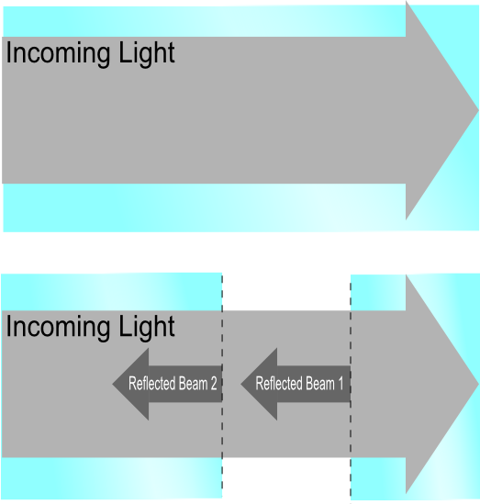

Slide 25
Review: Infinite Sheet of Charge
+
+
+
+
+
+
+

Slide 26
Review: Infinite Sheet of Charge
+
+
+
+
+
+
+

Slide 27
Review: Infinite Sheet of Charge
+
+
+
+
+
+
+

Slide 29
A
A
A
A
A
A
A
A
A
A
A
A

Slide 31
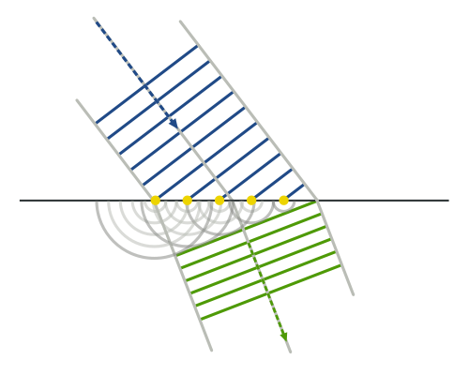
Arne Nordmann (norro)

Slide 32
Incoming Plane Wave
Scatterers
Spherical scattered wave forming

Slide 37
Reflected Plane Waves

Slide 38
Steered Radar Beam
RF Emitters with phase delays

Slide 39
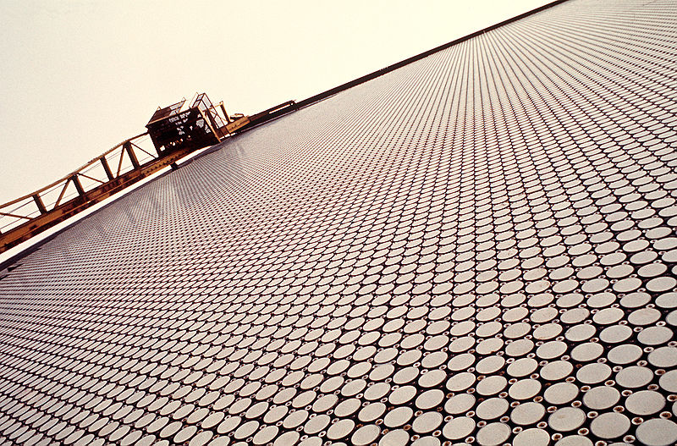
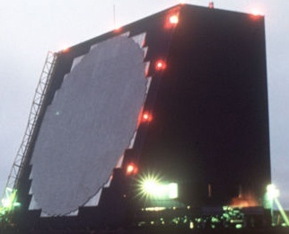
Cobra Dane Radar

Slide 40
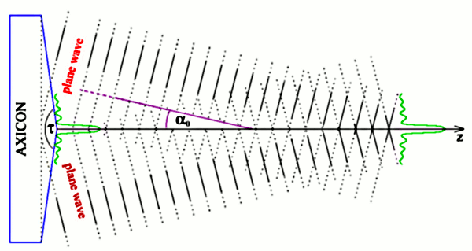
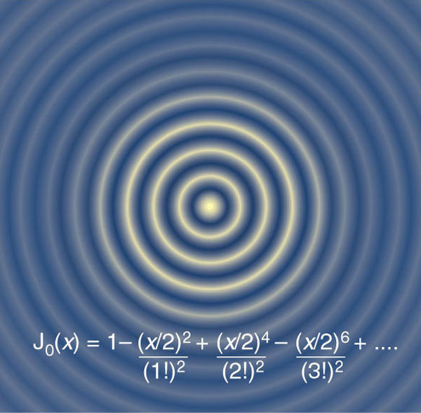
http://www.isibrno.cz/omitec/index.php?action=bessintr.html
http://www.nature.com/materials/nanozone/newsandviews/020912/419125a_f1.html

Slide 42
B
C
θ_{i}
θ_{i}
θ_{r}
θ_{r}
A
D

Slide 43
Wave Crests
Rays

Slide 44
Question 9.1
A specular reflector is ……..
A reflector that is spectacular!
One that can cook a hot dog
Like a mirror
A rough surface

Slide 45
Rays

Slide 46
θ
θ

Slide 47
Question 9.2
A diffuse reflector is ……..
A reflector that is spectacular!
One that can cook a hot dog
Like a mirror
A rough surface

Slide 52
Question 223.14.1
To the left is a photo of several light beams. Is the light traveling
from the right to the left
From the left to the right
Can’t tell

Slide 53
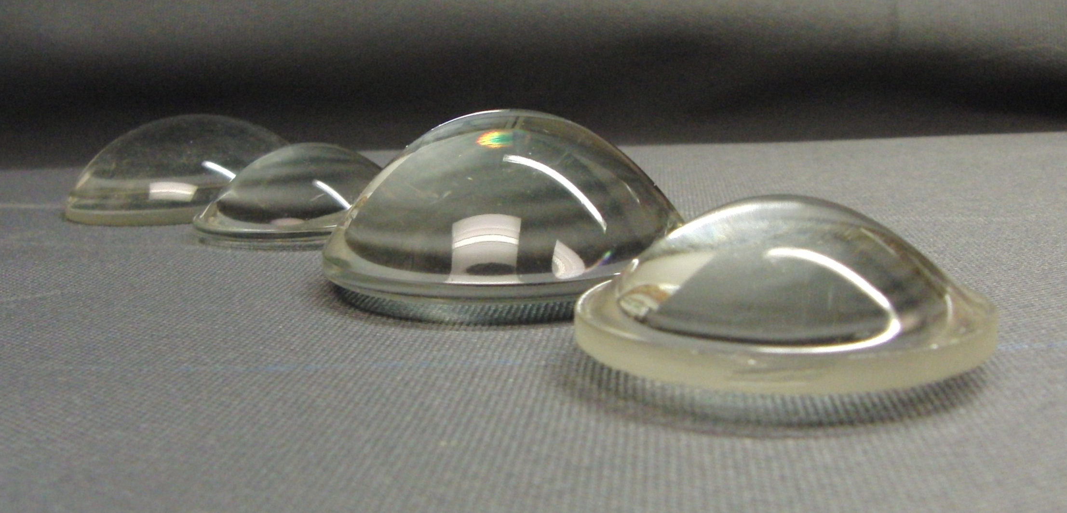

Slide 54
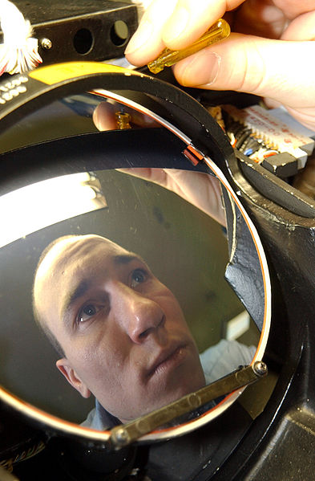

Slide 55
Question 223.14.1.5
We have found that when a wave enters a material, its speed may change. But we remember from wave theory v=λf But it is time to review: does λ change, or does f change? Wavelength
Frequency
Both
Can’t tell

Slide 56
Question 233.14.2
Suppose we have a material with an index of refraction of 2. What is the speed of the light in this material?
c/2
c/4
2c
4c
Can’t tell

Slide 57
Question 223.14.3
Light passes from a material with index of refraction 1.3 into one with index of refraction 1.2. Compared to the incident ray, the refracted ray
bends toward the normal
is undeflected
bends away from the normal

Slide 58
Question 223.14.4
If beam 1 is an incident beam, which of the other four beams lines are reflected beams and which are refracted beams?
Only beam 2 is reflected.
Only beam 4 is reflected.
Beams 2 and 4 are reflected.
Beams 2, 3, and 4 are reflected.
All five of the other lines are reflected.
1
2
5
3
4
6

Slide 59
Incident Ray
Reflected Ray
θ₁
θ₃
Air
Fast
n₁ (Small)
Glass
Slow
n₂ (Large)
θ₂
Transmitted Ray

Slide 61
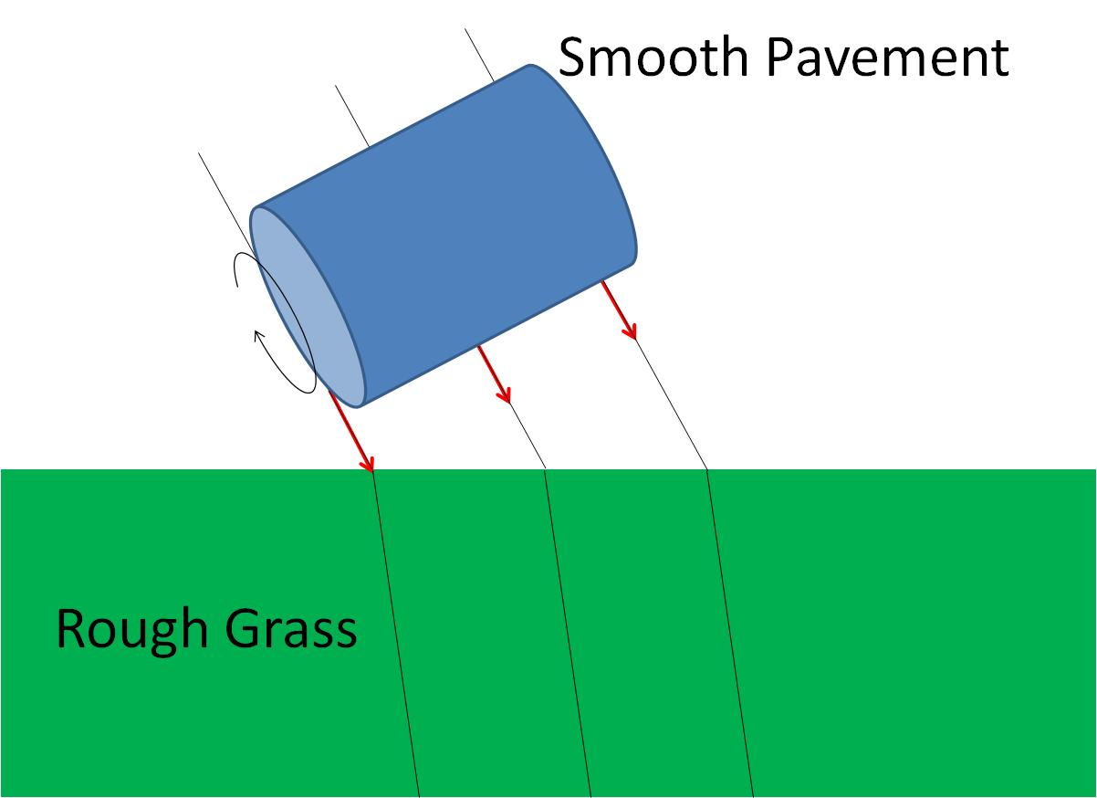
Smooth Pavement
Rough Grass

Slide 62
Smooth Pavement
Rough Grass

Slide 63
Smooth Pavement
Rough Grass

Slide 64
θ_{i}
θ_{t}

Slide 65
θ
φ

Slide 66
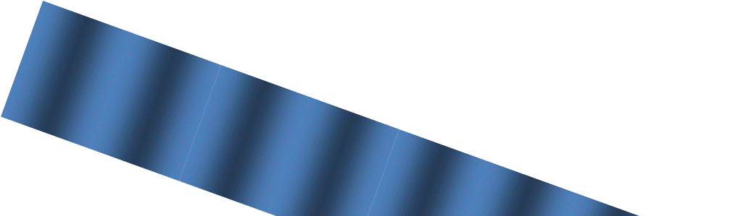

B
θ_{i}
θ_{i}
D
A
θ_{t}
θ_{t}
C

Slide 67
S
D
B
θ_{i}
θ_{r}
Mirror Surface
A
S’

Slide 68
S
θ_{i}
h
x
n_{i}
O
n_{t}
b
θ_{t}
P
a
x-a

Slide 69
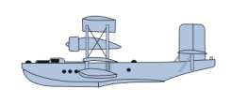
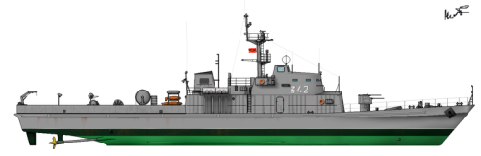

Slide 71

